Slide 1
T2S: Talk to(2) Slides
NAVER AI BURNING DAY
팀명: 누뗄라(김상엽, 김선욱, 박수형, 이용진)

Slide 2

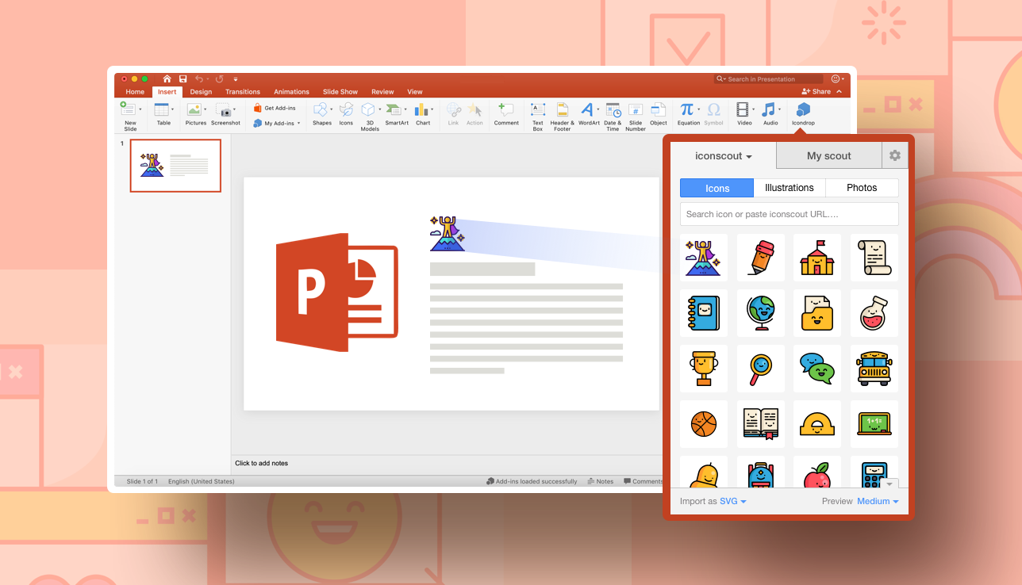
What is T2S?
T2S

Slide 3
Overview
S
P
E
E
C
H
V
O
I
C
E
F
I
L
E
T
E
X
T
F
I
L
E
KEY
WORD
M
A
R
K
D
O
W
N
F
I
L
E
S
L
I
D
E
S
① Recorder
② CSR
③ NLP
④ Image
Search
⑤ DarkSlide
③
①
②
④
⑤
I
M
A
G
E

Slide 4
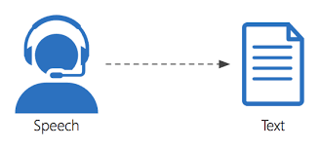
② CSR(Clova Speech Recognition)
NAVER CSR AI API

Slide 5
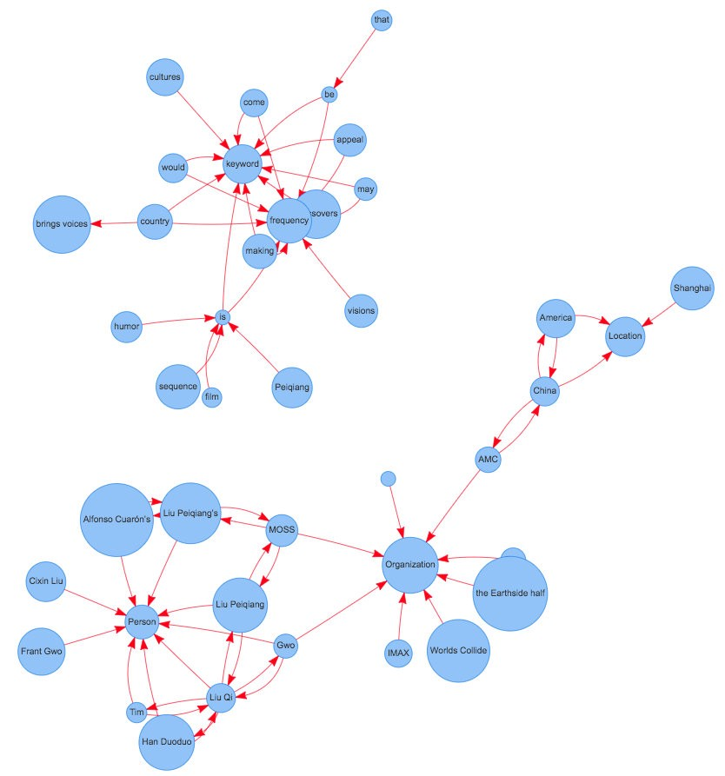
③ NLP(Natural Language Processing)
출처:
https://towardsdatascience.com/textrank-for-keyword-extraction-by-python-c0bae21bcec0?gi=5bb433179f0

Slide 6


④ Image Search
NAVER Image Search REST API

Slide 7
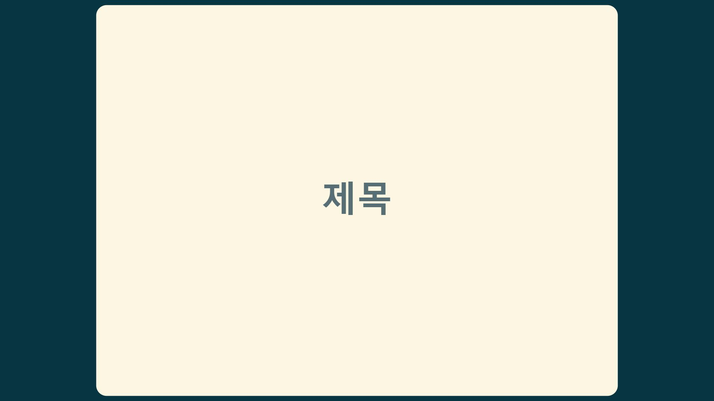
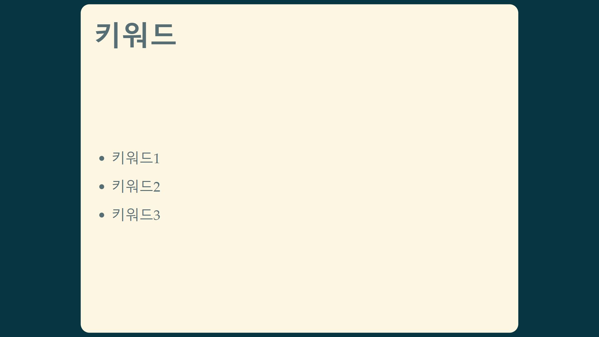
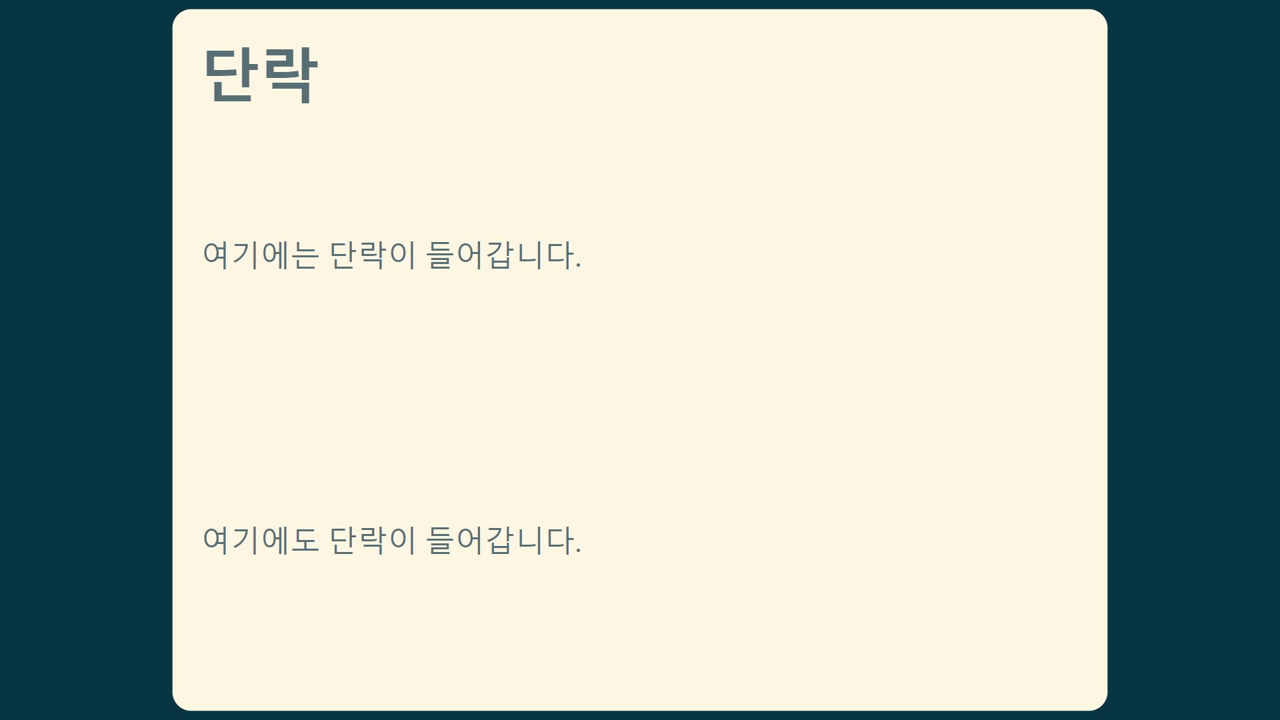
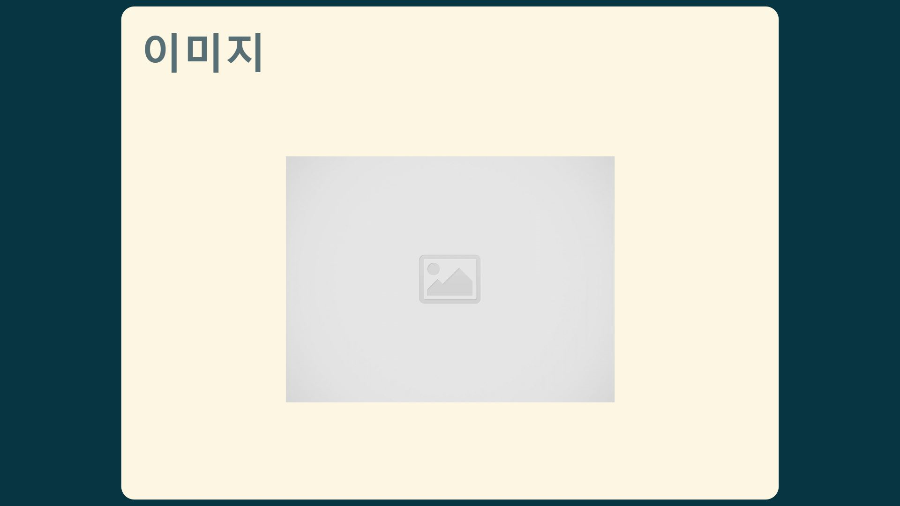
⑤ DarkSlide
Lightweight markup language slides generator

Slide 8
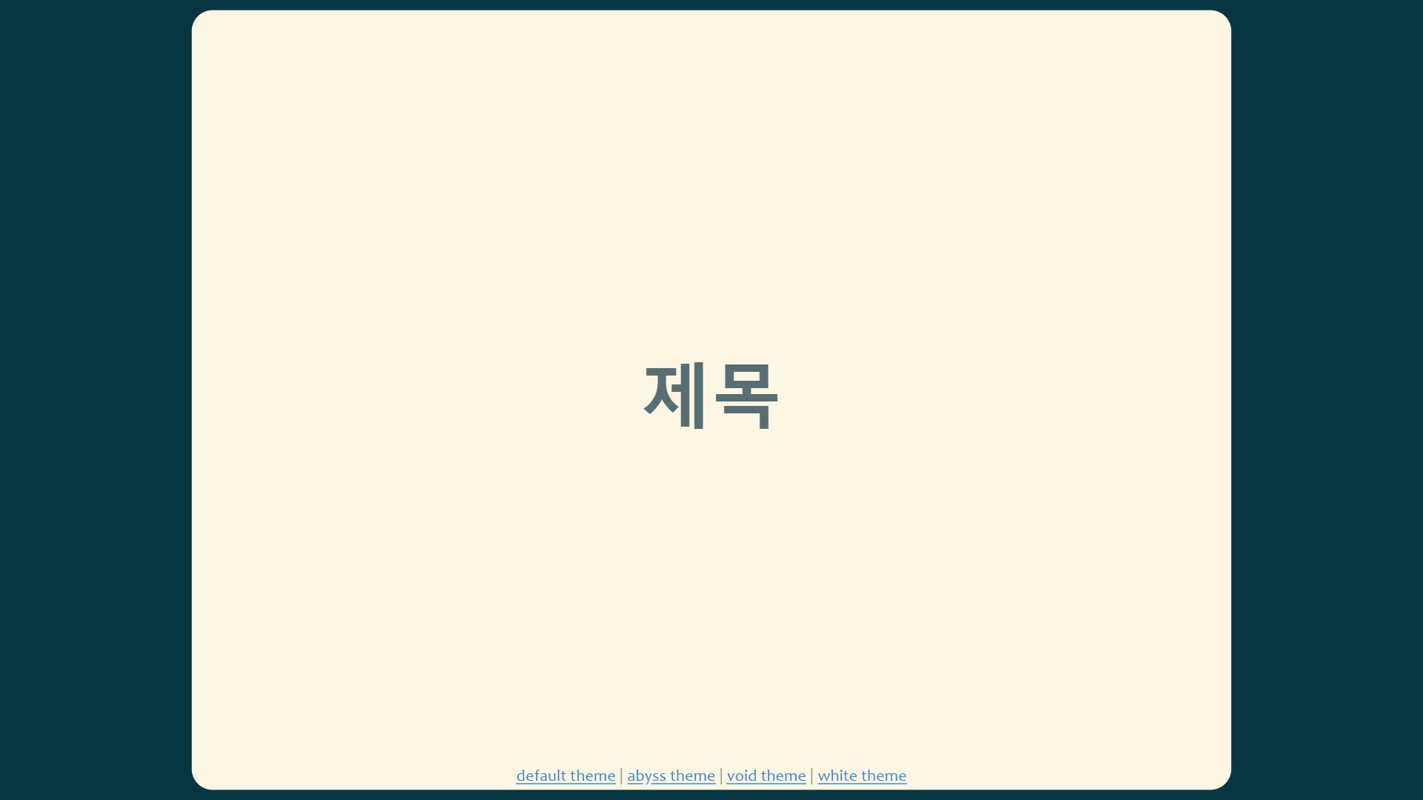
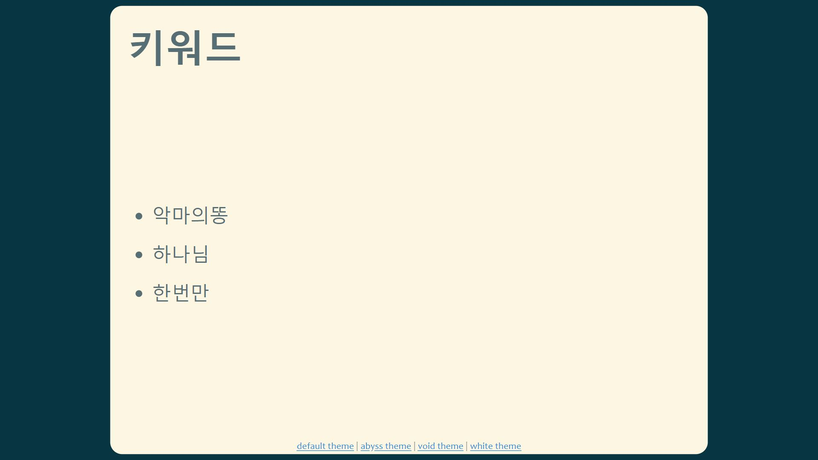
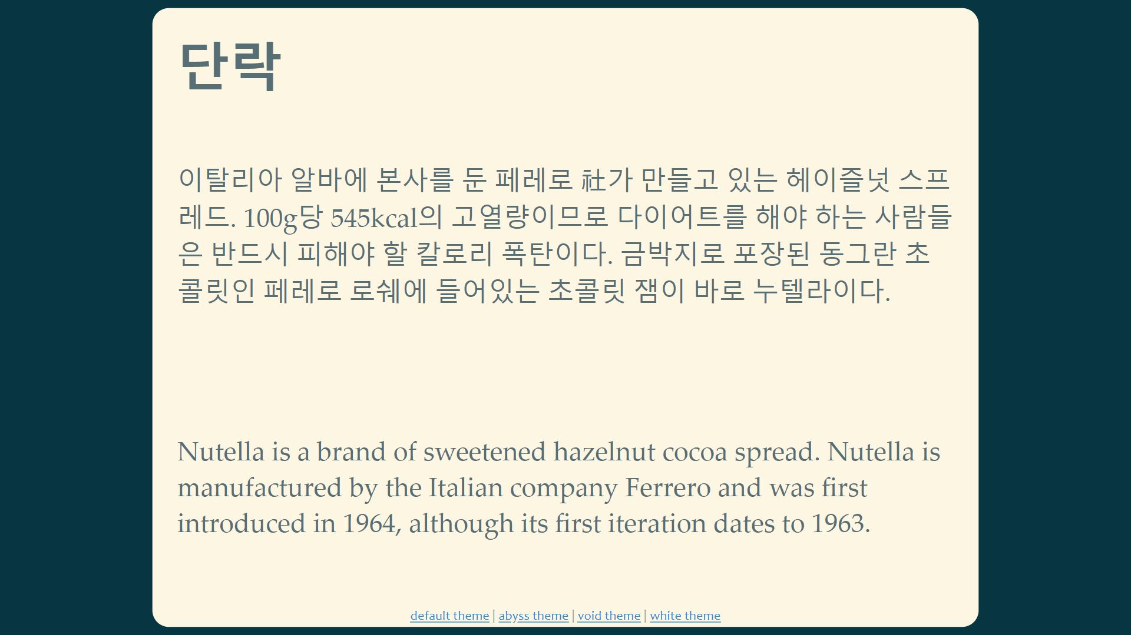
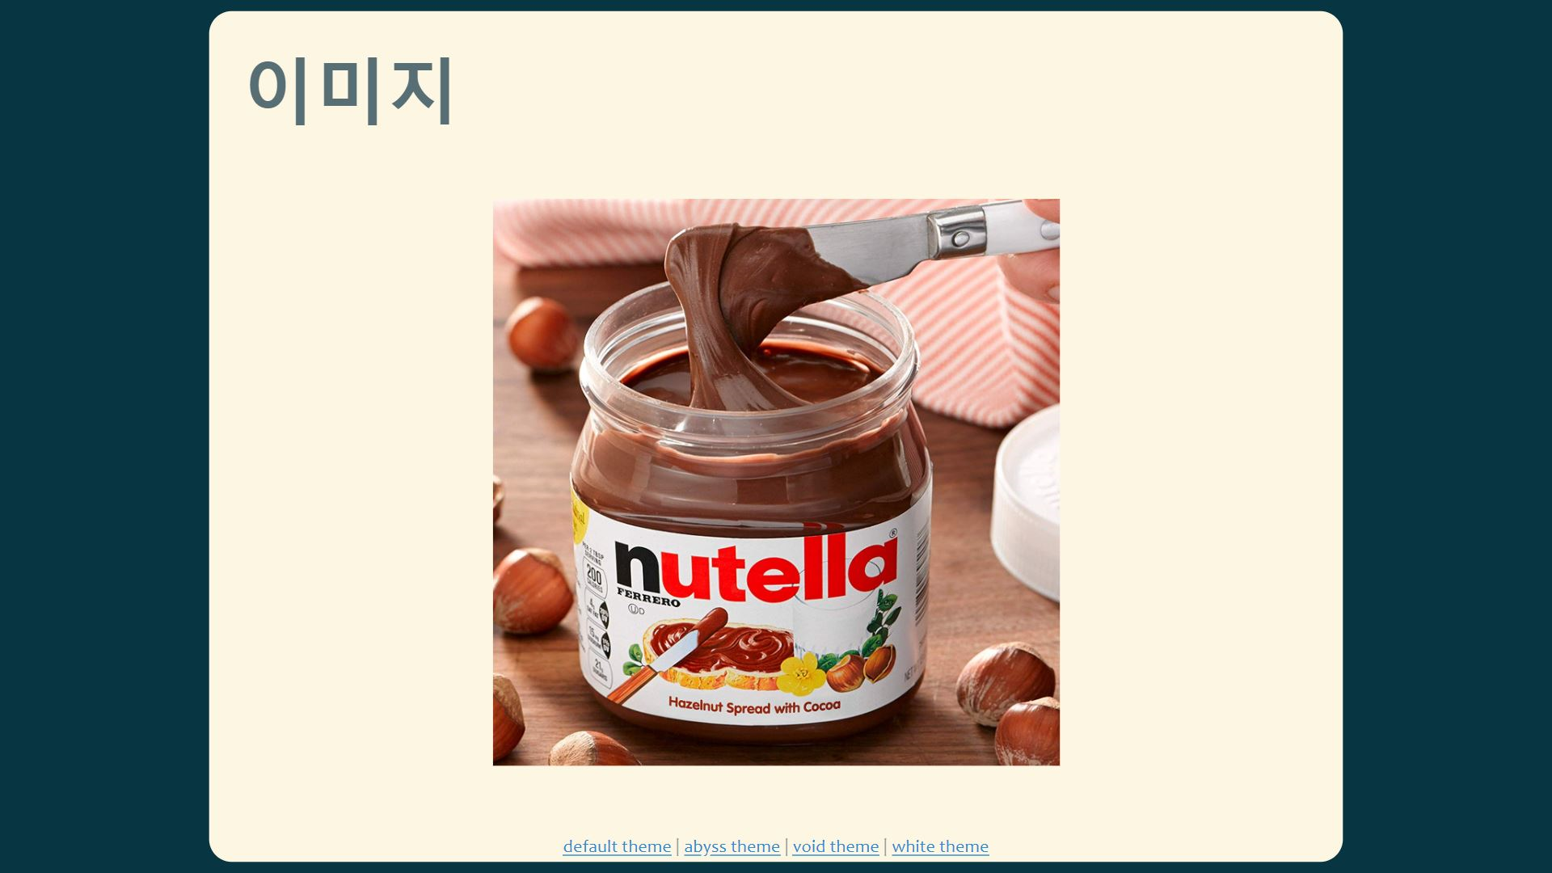
데모

Slide 9

Why T2S?

